Slide 1
GROUP -7 REAL TIME FACE MASK DETECTOR
NANCY SOM
NIDHI MITRA
NIKITA MOGHA
NISHA
TITIKSHA SAINI

Slide 2
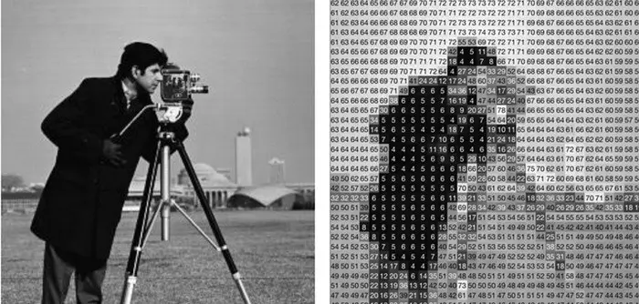
Introduction to Image Processing Images are simply a collection of colors in red,green, and blue format. As a human, we see an image with some object or shape in it, but for computers it is just an array with color values ranging from 0 to 255

Slide 3
Steps to Perform Image Processing : -Load images using Python or any other programming you are working on. -Convert images into array -And finally apply some algorithm on that array

Slide 4
Introduction to OpenCV -OpenCV (Open Source Computer Vision Library) is an open source computer vision and machine learning software library. -The library has more than 2500 optimized algorithms. -It has C++, Python, Java and MATLAB interfaces and supports Windows, Linux, Android and Mac OS. -Will help us to load images in Python and convert them into array. -Each index of array represents (red, green, blue) color pixel which ranges from 0 to 255.

Slide 5
Features of OpenCV -Face Detection -Geometric Transformations -Image Thresholding -Smoothing Images -Canny Edge Detection -Background Removals -Image Segmentation

Slide 6
VIOLA AND JONES ALGORITHM

Slide 7
The Viola–Jones object detection framework is an object detection framework which was proposed in 2001 by Paul Viola and Michael Jones. Although it can be trained to detect a variety of object classes, it was motivated primarily by the problem of face detection.

Slide 8
The problem to be solved is detection of faces in an image. A human can do this easily, but a computer needs precise instructions and constraints. To make the task more manageable, Viola–Jones requires full view frontal upright faces.

Slide 9
The characteristics of Viola–Jones algorithm which make it a good detection algorithm are:
Robust – very high detection rate (true-positive rate) & very low false-positive rate always.
Real time – For practical applications at least 2 frames per second must be processed.
Face detection only (not recognition) - The goal is to distinguish faces from non-faces.

Slide 10
The algorithm has four stages:
Haar Feature Selection
Creating an Integral Image
Adaboost Training
Cascading Classifiers

Slide 11
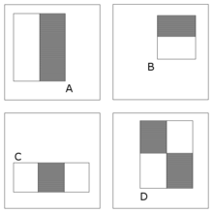
The 4 Types of haar features

Slide 12

All human faces share some similar properties. These regularities may be matched using Haar Features.
A few properties common to human faces:
The nose bridge region is brighter than the eyes.

Slide 13

The eye region is darker than the upper-cheeks.

Slide 14
The four features matched by this algorithm are then sought in the image of a face.
Rectangle features:
Value = Σ (pixels in black area) - Σ (pixels in white area)
If this value is close to 1 that means that there is a haar feature.
If this value is close to 0 that means that there is no possibility of a face being available or a face/haar feature there.
Then wherever the face features are detected it says that there is a face available in that particular sliding window.
If Face is detected it will return the x,y,w,h (x , y , width , height) of the location of the face.

Slide 15
Now, there are a lot of pre-built files to use known as haar cascade data.
In our project we use – haarcascade_frontalface_default.xml
With the help of this xml file we will be able to detect all the faces.

Slide 16
NUMPY
Numpy stands for numerical python and handles n-dimensional array in python.
Array stores the RGB values of images.

Slide 17
-The with mask images is saved in the file with_mask and without mask images is saved in the file without_mask. -Images in the files are reshaped and converted from 4-D to 2-D so that implementation becomes easier and complexity is reduced. -Labels stores first 400 pointing to with mask and having values 0,rest 400 pointing to without mask and value 1.

Slide 18
Output 0 means wearing mask. Output 1 means not wearing mask. - A dictionary is used to represent the values of 0 and 1.

Slide 19
SKLEARN LIBRARY
Sklearn (or Scikit-learn) is a Python library that offers various features for data processing that can be used for classification, clustering, and model selection.

Slide 20
Model_selection is a method for setting a blueprint to analyze data and then using it to measure new data. Selecting a proper model allows you to generate accurate results when making a prediction.
To do that, you need to train your model by using a specific dataset. Then, you test the model against another dataset.

Slide 21
If you have one dataset, you'll need to split it by using the Sklearn train_test_split function first.
train_test_split is a function in Sklearn model selection for splitting data arrays into two subsets: for training data and for testing data.

Slide 22
Sklearn test_train_split has several parameters. A basic example of the syntax would look like this:
train_test_split(X, labels, test_size=0.25)
- X is the 800.
- Labels = Mask or Non-mask (0/1)
test_size. This parameter specifies the size of the testing dataset.

Slide 23
SVC MODEL
The objective of a Linear SVC (Support Vector Classifier) is to fit to the data you provide, returning a "best fit" hyperplane that divides, or categorizes, your data..

